Slide 1
Euthanasia & Assisted dying- The slippery slope
A Global perspective
Notes:
When we look to change any law especially in relation to human life ,those in positions of influence and those in governance have a duty to look critically and honestly at the impact of that law in other countries. In the next 20 mins I want to look at the reasons behindthe right to die movement and unpack some of the key slogans. I want to look then at whats happening outside of Ireland and the UK in those countries where the law has been changed to give patients the right to die. What lessons we can learn from their experience.

Slide 2
The ‘Right to Die’ Movement
Efforts to change government policies on euthanasia of human lives in the 20th and 21st centuries have met success in Western countries. Human euthanasia policies have also been developed by a variety of NGOs, and advocacy organizations. As of March 2018, human euthanasia is legal in the Netherlands, Belgium, Colombia,^{[1]} Luxembourg, Canada^{2]} and India^{3]}.
Assisted suicide is legal in Switzerland, Germany, Japan, and in the US states of Washington, Oregon, Colorado, Vermont, Montana, Washington DC,^{[4]} and California.^{[5]} South Korea is also set to join as a euthanasia-legal country starting from February 2018, both active and passive. An assisted dying scheme in the Australian state of Victoria will come into effect in mid-2019.

Slide 3
Persuasive language & Assurances
Rare, strict safeguards against abuse
‘Dying with dignity’
‘Medical aid in dying’
‘The relief of suffering’
‘ Personal autonomy’
‘Completed life act’

Slide 4
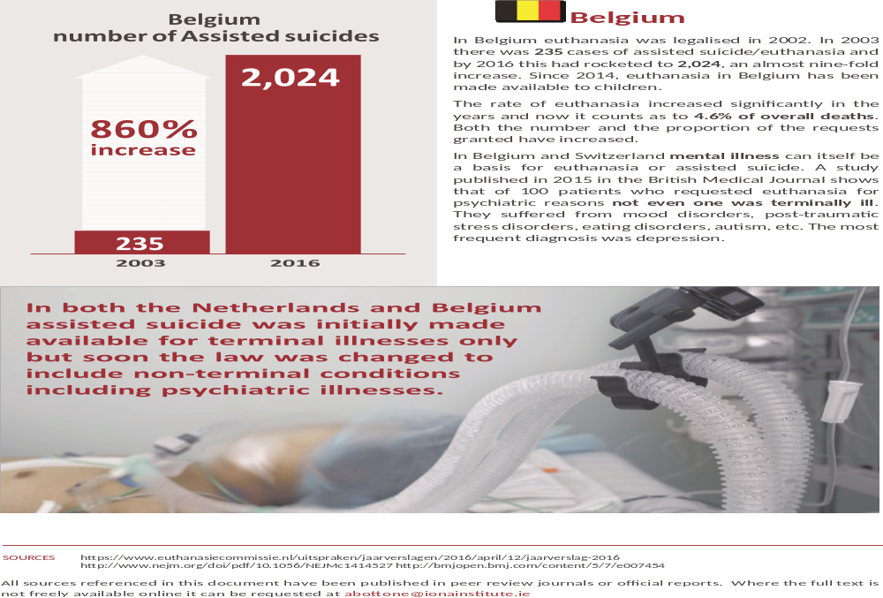

Slide 5
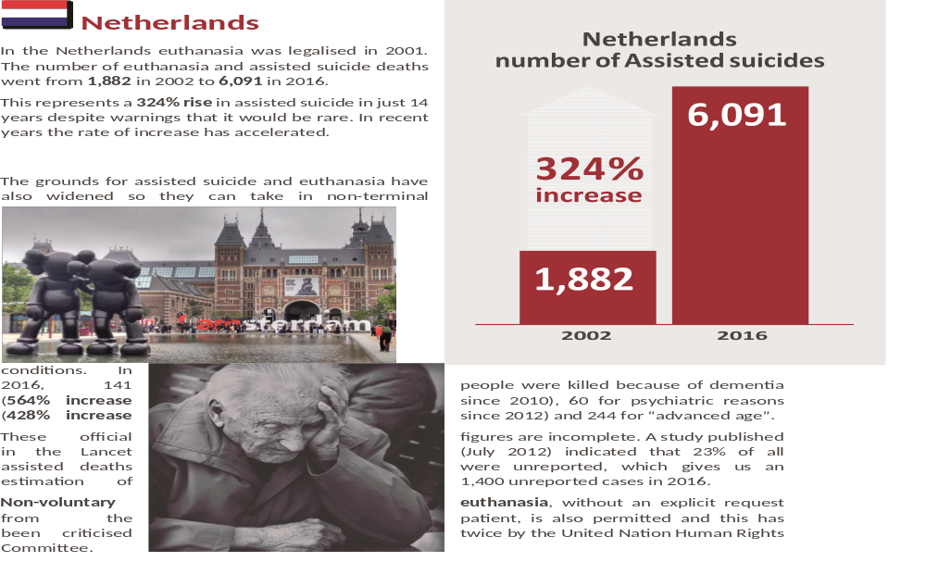

Slide 6
The Slippery Slope
“Being over the age of 70 and tired of living’ should be an acceptable reason for requesting Euthanasia. (Royal Dutch Medical association 2006)

Slide 7
The Quebec Experience
‘Medical aid in dying' law- came into effect on December 10, 2015.
Promises of advocates of the law included the following
This would be an exceptional measure for exceptional cases,
There would be safeguards to prevent abuse, and that very
Strict criteria would protect vulnerable people.
Proponents claimed it was 'first and foremost a law about access to quality palliative care throughout the province”

Slide 8
Quebec – The Practical Consequences
After just 2 years comparisons are being made with the Belgian experience.
Advocates predicted around 100 requests in first year.
469 people died by euthanasia in 2015-2016,
638 people died by euthanasia - 2017

Slide 9
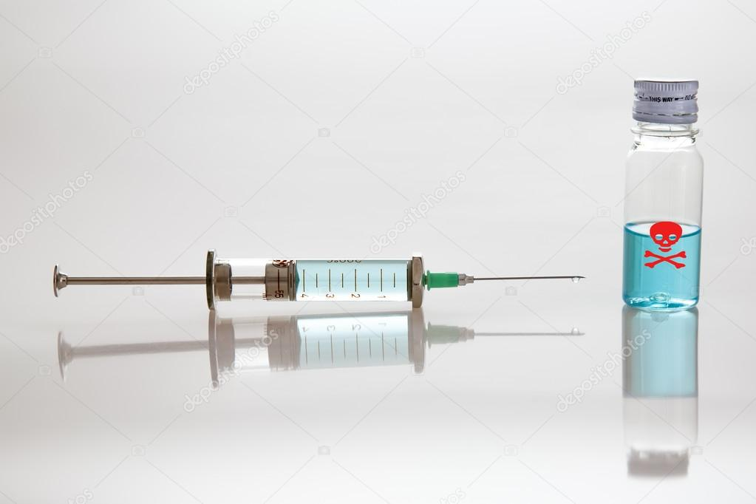
Duty to Die?

Slide 10
What They Say….
Gilles Genicot is a lawyer and co-Chairman of the Euthanasia Control and Evaluation Commission, which oversees the practice in Belgium.
“The law humanizes– the deaths of terminally ill patients, on the one hand, and on the other hand, for patients who are not terminally ill but who are completely hopeless, there is a respect to the individual autonomy. I think it’s a major advance in the way society, law and– philosophy see this very important issue”.

Slide 11
The Chill Factor – Law & Culture
Almost half of Belgium’s euthanasia nurses have admitted to killing without consent, despite the fact that involuntary euthanasia is illegal in Belgium and that nurses are not allowed to perform even voluntary euthanasia.
In 2007 approximately 10% of all deaths in the Netherlands were connected to the practice of terminal sedation. Many of those deaths were caused by dehydration, by the physician sedating the patient and then withholding hydration until death occurs, which usually takes 10 – 14 days.
Grand Duke Henri, the monarch of Luxembourg, opposed the euthanasia law and as a result was stripped of his executive power to veto laws.

Slide 12
No Questions Asked – Inadequate safeguards
Tom Mortiers whose mother was euthanised by lethal injection following severe depression in 2012 in Belgium is taking case to ECHR as Dutch courts refused to give the case a hearing.
Arguing it violates the basic obligation of the state to protect the “right to life.”
“ What we see in Belgium is a slippery slope. We see the number of euthanasia deaths rising year in, year out since the legalization in 2002. And what we see is completely inadequate oversight. The committee that monitors them has received just over 8000 notifications of euthanasia deaths since the legalization. In its history of those 8,000 cases the committee has submitted not a single one to the public prosecutor.”
Robert Clarke – Alliance Defending Freedom 2017

Slide 13

Dignitas – Facility Switzerland
Soraya Wernli, a nurse employed by Dignitas between 2003 and 2005, has accused the organisation of being a ‘production line of death concerned only with profit’

Slide 14
Dignitas, Switzerland
Many who have died at the Dignitas facility are not terminally ill. Ludwig Minelli, the Director, has helped people who are chronically ill, disabled, depressed or frail or elderly to kill themselves and has suggested the relations of the terminally ill could also take a lethal drug cocktail even if they are in perfect health.
The Dignitas facility had to move from the residential apartment block it was located in after residents complained about encountering body bags in the lifts.
.

Slide 15
The Chilling Facts
Using organs from euthanasia victims is now an established procedure in Belgium.
At least 300 cremation urns containing human remains have been dumped in Lake Zurich near the controversial Swiss suicide facility Dignitas.
A recent study found that in the Flemish part of Belgium, 66 of 208 cases of ‘euthanasia’ (32%) occurred in the absence of request or consent.
In Belgium, nearly half of all cases of euthanasia are not reported to the Federal Control and Evaluation Committee. Legal requirements were more frequently not met in unreported cases than in reported cases and a written request for euthanasia was absent in 88%.
Dozens of disabled children have been killed under the Groningen protocol in the Netherlands despite the fact that this is illegal.

Slide 16
Law Expands Rapidly
Laws in the Holland and Belgium that were only meant to apply to mentally competent terminally ill adults, have been extended to include the elderly, disabled, those with mental health problems and worryingly even non-mentally competent children. While in Oregon, the model often cited by those wanting to change the law, there are examples of cancer patients being denied lifesaving and life extending drugs, yet offered the lethal cocktail of barbiturates to end their own lives.

Slide 17
Challenges to UK Law
There have been over ten attempts to legalise assisted suicide through British Parliaments since 2003, all of which have failed.
2015, defeated by an overwhelming majority of 330 to 118 in the House of Commons amidst real and well-founded concerns about public safety.
According to a 2005 House of Lords Select Committee Report a Dutch-type euthanasia law in Britain would result in 13,000 deaths per year.

Slide 18
Law changes Culture of Care
“Discriminating against the terminally ill and disabled people in law, by removing important and universal protections, risks putting pressure on vulnerable people to end their lives, because of real or imagined fears of being a burden upon relatives, carers, or on a state and health care system that is desperately short of resources.
The safest law is one like Britain's current law, which gives blanket prohibition on all assisted suicide and euthanasia. This deters exploitation and abuse through the penalties that it holds in reserve, but at the same time gives some discretion to prosecutors and judges to temper justice with mercy in hard cases.” Dr Peter Saunders (Care not killing Alliance)

Slide 19
The Slippery Slope: Eugenics
The Nazi holocaust began in 1939 with the killing of 6,000 disabled children and 70,000 patients in geriatric and psychiatric institutions
“Its beginnings at first were merely a subtle shift in emphasis in the basic attitude of the physicians. It started with the attitude, basic in the euthanasia movement that there is such a thing as a life not worthy to be lived. This attitude in its early stages concerned itself merely with the severely and chronically sick. Gradually the sphere of those to be included in this category was enlarged to encompass the socially unproductive, the ideologically unwanted, the racially unwanted and finally all non-German”
-Leo Alexander, (a psychiatrist who gave evidence at Nuremberg in 1949)

Slide 20
Does Indirect or Passive Euthanasia Exist in Northern Ireland?
Anecdotal evidence
Increasing morphine & Withdrawing hydration.
Confusion surrounding appropriate time to take down drip or withdraw other life sustaining treatment.
Crisis in home from hospital care
Pressure on bed space
Shortage of adequately trained care workers
Diminished sense of ‘vocation’ to care for the elderly & terminally ill.

Slide 21
What we can do.
Help inform others
Challenge illusive language
Ensure elderly, sick,terminally ill are getting the best care possible
Ensure plan of care is not intentionally life ending
Every human person is deserving of love, dignity and care

Slide 22
“In a society that is deeply uncomfortable with incapacity and disability, and sees ageing only as a terrible decline, legalising euthanasia would be a sinister victory for the forces of Western individualism, one which will tear at the fabric of our collective humanity and our responsibility to the greater good.”
Because, ultimately, the assisted dying legislation creates different categories of human life: some worth living, some not. It's a law not about how people should die, but about whether people should live - and the state should have no say in that.”
Assisted Dying Legislation Creates Different Categories of Human Life' by Emma Dawson 2017

